Slide 1
Blazing the Web - Building Web Applications in C#
Jason Bock

Slide 2
Personal Info
http://www.jasonbock.net
https://www.twitter.com/jasonbock
https://www.github.com/jasonbock
jason.r.bock@outlook.com

Slide 3
Downloads
https://github.com/JasonBock/BlazingTheWeb
https://github.com/JasonBock/Presentations

Slide 4
Overview
History
WebAssembly
Blazor
Final Thoughts
Conclusion
Remember…
https://github.com/JasonBock/BlazingTheWeb
https://github.com/JasonBock/Presentations

Slide 5

History
http://foodnetwork.sndimg.com/content/dam/images/food/fullset/2008/3/5/0/NY0100_BBQ-Spaghetti.jpg#Spaghetti%20811x608
Notes:
JavaScript was meant to be a scripting languages for documents. Pushing it any farther than that and it was difficult to prevent spaghetti code from happening.

Slide 6





History
Notes:
Over time, developers creates packages and modules to make web development easier.

Slide 7


History
Notes:
Ironically, JavaScript started to spread everywhere, and has become as close to “one language to rule them all” as any other has become.

Slide 8




History
Notes:
Now, for some….this isn’t a great thing. Sure, JavaScript has some good parts, but people enjoy other languages. However, this is still transpiled.

Slide 9

History
<script type="text/csharp" src="code.cs"></script>
<script type="text/ruby" src="code.rb"></script>
<script type="text/python" src="code.py"></script>
Notes:
And these developers would probably love to reuse their code in the browser (or Node.js), but there’s no choice. The ONLY language that the web understands is JavaScript….at least until WebAssembly.

Slide 10









History
Notes:
This is kind of weird when you think about it. Most languages can work anywhere, but JavaScript has pushed web development to a mono-language culture. As you’ll see, this is no longer the case.

Slide 11

History
http://blog.cmaresources.org/wp-content/uploads/2012/05/speed2.jpg
Notes:
Not to be deterred, the JS community came up with asm.js and emscripten.

Slide 12
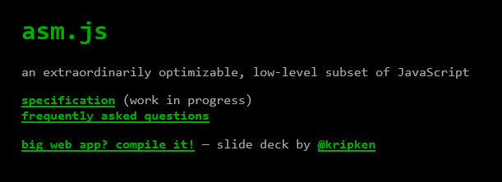

History
http://asmjs.org
http://kripken.github.io/emscripten-site/
Notes:
So, sure, you make JavaScript work. But….there’s performance. JavaScript is an interpreted language. You can use minifiers to reduce the amount of textural JS that you ship to a browser or run in Node, but it has to be interpreted on the fly. There’s a performance cost involved that can’t be eliminated with this approach.

Slide 13
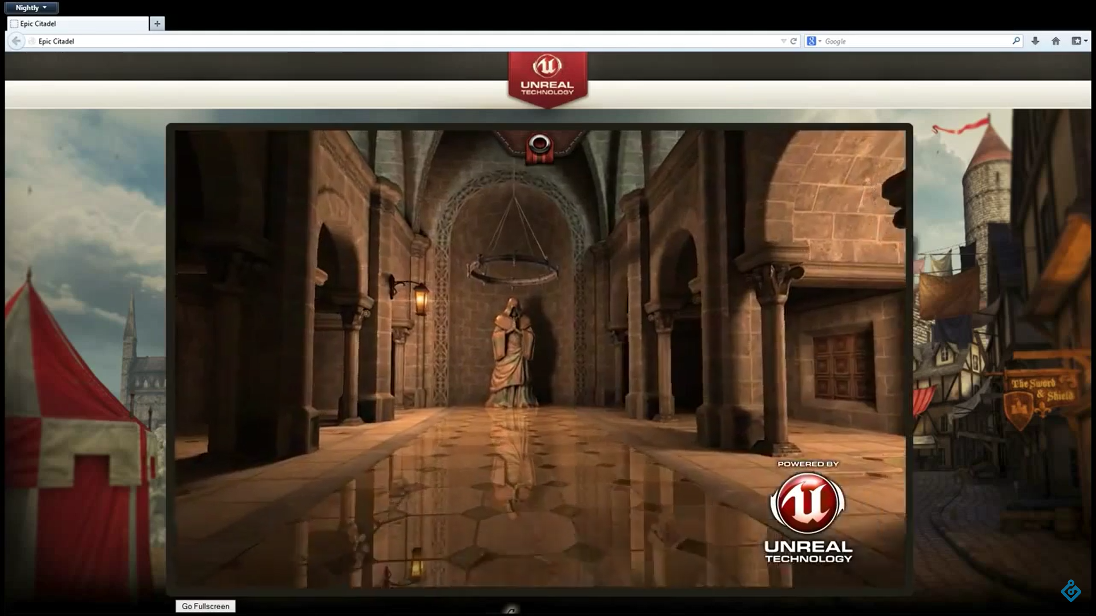
History
https://youtu.be/nB9Pm9Mr7xo
Notes:
And then you can do an Unreal demo in the browser, which is actually pretty impressive. But none of this is standardized.

Slide 14

WebAssembly
https://github.com/carlosbaraza/web-assembly-logo
Notes:
Enter WebAssembly

Slide 15
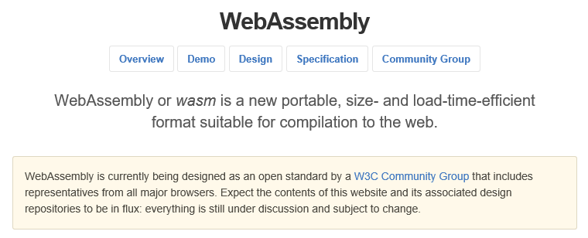
WebAssembly
http://webassembly.github.io/
Notes:
WebAssembly is fundamentally the same thing as asm.js, but done as an open standard for web developers.

Slide 16

WebAssembly
https://twitter.com/linclark/status/836609222733348864/photo/1
Notes:
Every browser has implemented it

Slide 17
WebAssembly
Efficient and fast
Safe
Open and debuggable
Part of the open web platform
Notes:
These come directly from the WebAssembly site:
Overview
•Efficient and fast: The wasm AST is designed to be encoded in a size- and load-time-efficient binary format. WebAssembly aims to execute at native speed by taking advantage of common hardware capabilities available on a wide range of platforms.
•Safe: WebAssembly describes a memory-safe, sandboxed execution environment that may even be implemented inside existing JavaScript virtual machines. When embedded in the web, WebAssembly will enforce the same-origin and permissions security policies of the browser.
•Open and debuggable: WebAssembly is designed to be pretty-printed in a textual format for debugging, testing, experimenting, optimizing, learning, teaching, and writing programs by hand. The textual format will be used when viewing the source of wasm modules on the web.
•Part of the open web platform: WebAssembly is designed to maintain the versionless, feature-tested, and backwards-compatible nature of the web. WebAssembly modules will be able to call into and out of the JavaScript context and access browser functionality through the same Web APIs accessible from JavaScript. WebAssembly also supports non-web embeddings.

Slide 18
Demo: Targeting WASM
Blazing the Web – Building Web Applications in C#
Notes:
Let’s do Collatz in WebAssembly

Slide 19
Blazor
C
C++
Rust
Swift
Go
Ruby
Dart
Python
Notes:
So, it’s very cool to see that other languages are targeting WASM.

Slide 20

Blazor
?
?
?
?
?
Notes:
But what about C#?

Slide 21

Blazor
https://blazor.net
Notes:
Blazor is a new UI framework from Microsoft that allows you to run C# via WebAssembly.

Slide 22
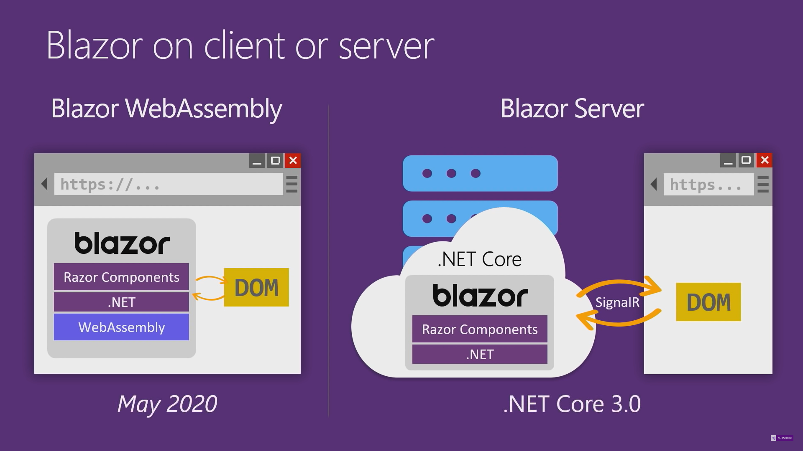
Blazor
https://www.youtube.com/watch?v=MetcuX1OHD0
Notes:
Blazor server-side comes with .NET Core 3.0. Client-side was released May 2020.

Slide 23
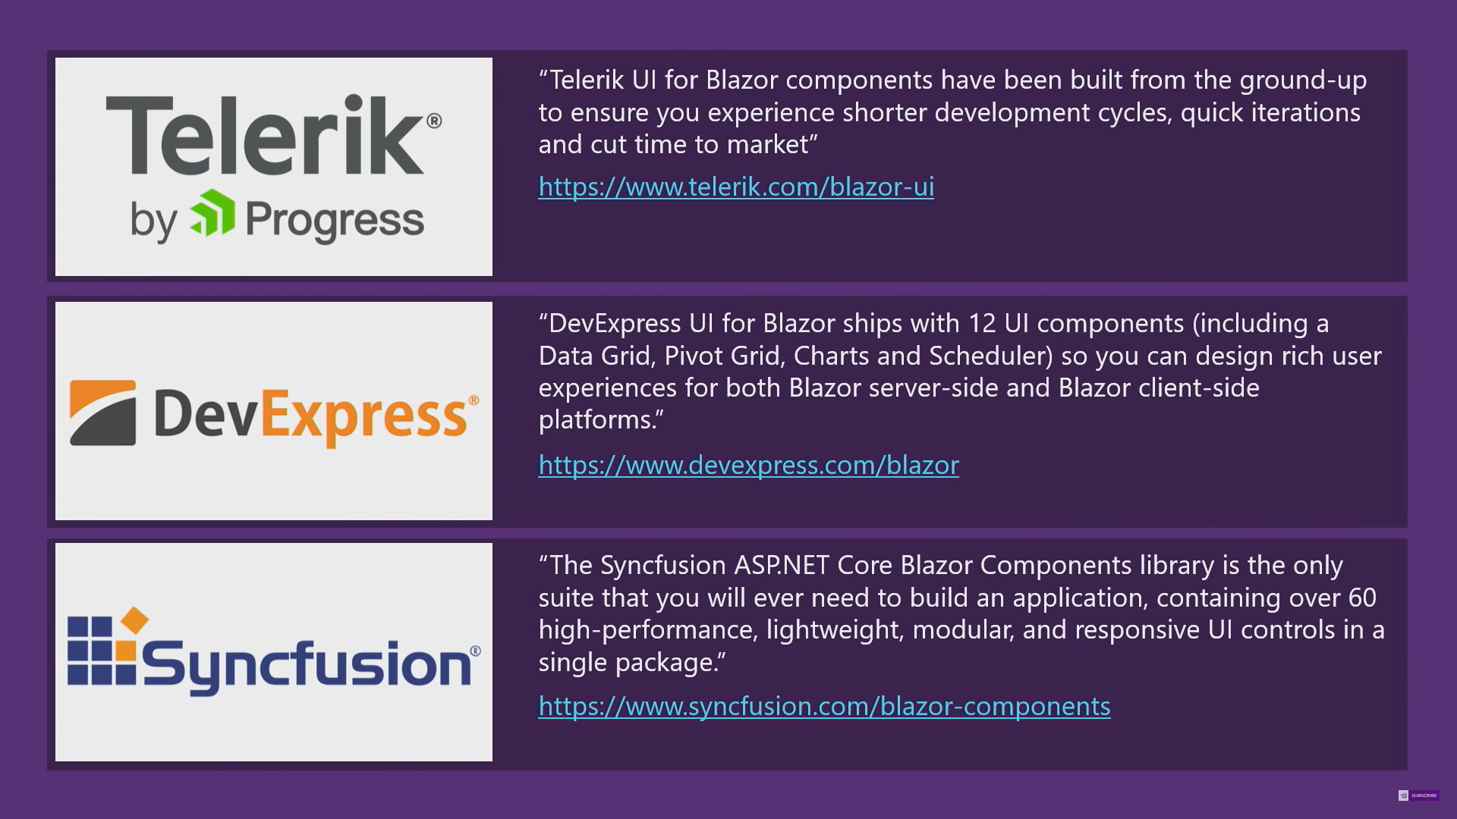
Blazor
https://www.youtube.com/watch?v=MetcuX1OHD0
Notes:
Third-party component vendors are already supporting Blazor.

Slide 24
Blazor
Projects
JS Interop
Routing
Components
Eventing
State
Testing
Threading
Hosting
Notes:
Projects – what different project templates are there, point out key aspects
JS Interop – interacting with JS is essential in the foreseeable future. Show Chart.js and geolocation
Routing – using route information to display information and pass data to the component
Components – what are they, what’s the lifecycle, how is code and UI handled, etc.
Eventing – think event aggregation, how do components “talk” to other parts of the application seamlessly
State – how does Blazor handle application state
Testing – unit, integration, also talk about MV* approaches
Threading – doing work “in the background”, how does that work
Hosting – think Blazor mobile here

Slide 25
Demo: Targeting Blazor
Blazing the Web – Building Web Applications in C#

Slide 26

Final Thoughts
https://formula1.files.wordpress.com/2016/05/season2016_race5_wallpapers_09.jpg
Notes:
WebAssembly is all about speed.

Slide 27

Final Thoughts
http://thebridge-can.com/wp-content/uploads/2014/09/Braveheart-Freedom-Slide.jpg
Notes:
WebAssembly is also about freedom.

Slide 28
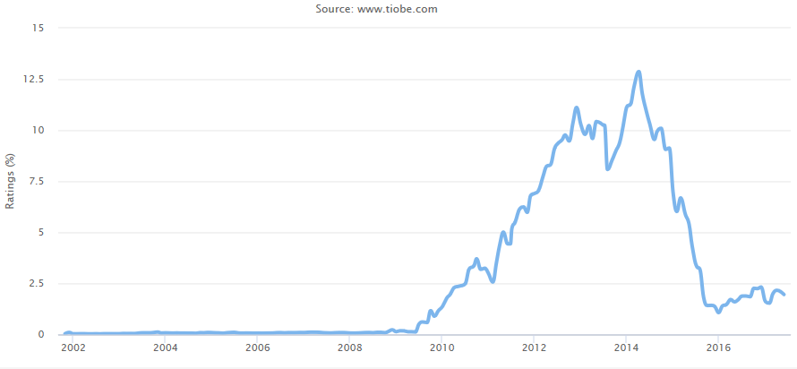



Final Thoughts
http://thebridge-can.com/wp-content/uploads/2014/09/Braveheart-Freedom-Slide.jpg
Notes:
Choice is good. Sometimes it can be overwhelming, but if developers can choose a language that they are comfortable with and feel productive in, the environment really shouldn’t be a constraint, especially on the web. With Swift (and to some degree, Xamarin), it’s clear that developers are starting to move away from Objective-C to other choices.

Slide 29
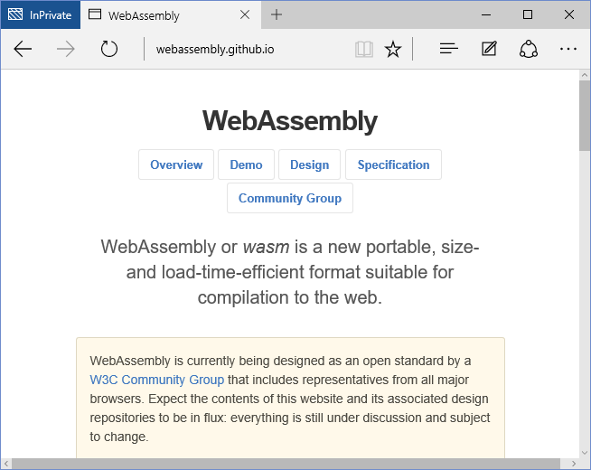



Final Thoughts
Notes:
Will this happen when wasm becomes mainstream? Time will tell….

Slide 30
Final Thoughts
WebAssembly for .NET - https://github.com/RyanLamansky/dotnet-webassembly
wasm2cil - https://github.com/ericsink/wasm2cil/
Notes:
And it’s possible to use code from ANY language if it targets WASM. This is language interoperability at a native level that is much simpler than p-invokes.

Slide 31
Demo: Using WASM in .NET
Blazing the Web – Building Web Applications in C#

Slide 32



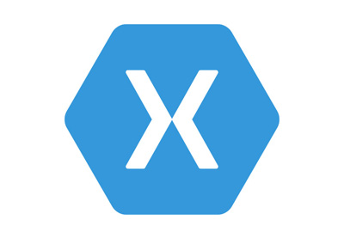


Conclusion
Notes:
Blazor has the potential to be the cross-platform UI strategy from MS, where you can build Uis for the web, or Electron, or native (Flutter, Electron, Xamarin, etc.).

Slide 33




Conclusion
Notes:
….but I’m confident, especially now that Blazor is supported by MS. The future is looking very bright!

Slide 34
Blazing the Web - Building Web Applications in C#
Jason Bock
Remember:
https://github.com/JasonBock/BlazingTheWeb
https://github.com/JasonBock/Presentations
References in the notes on this slide
Notes:
References
Blazor - https://blazor.net/ (https://dotnet.microsoft.com/apps/aspnet/web-apps/client)
Blazor University - https://blazor-university.com/
Awesome Blazor - https://github.com/AdrienTorris/awesome-blazor
A new experiment: Call .NET gRPC services from the browser with gRPC-Web - https://devblogs.microsoft.com/aspnet/grpc-web-experiment/
Using gRPC-Web with Blazor WebAssembly - https://blog.stevensanderson.com/2020/01/15/2020-01-15-grpc-web-in-blazor-webassembly/
Mobile Blazor Bindings – Getting Started + Why You Should Care - https://www.dylanberry.com/2020/02/05/mobile-blazor-bindings-getting-started-why-you-should-care/
Fragment Routing with Blazor - https://chrissainty.com/fragment-routing-with-blazor/
Blazor by Example - Build a simple traffic light - https://jonhilton.net/blazor-traffic-light/
Blazor.Animate - https://github.com/mikoskinen/Blazor.Animate
Blazor by Example - Build a simple markdown editor - https://jonhilton.net/blazor-markdown-editor/
6 Blazor component libraries to speed up your development - https://jonhilton.net/blazor-component-libraries/
WebAssembly
WebAssembly - https://webassembly.org/
Hashing - https://antelle.github.io/argon2-browser/
Animation Demo - http://aws-website-webassemblyskeletalanimation-ffaza.s3-website-us-east-1.amazonaws.com/
WebAssembly: A New Hope - https://pspdfkit.com/blog/2017/webassembly-a-new-hope/
Faster Fractals with Multi-Threaded WebAssembly - https://blog.scottlogic.com/2019/07/15/multithreaded-webassembly.html

